Slide 1
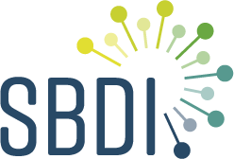
ASV portal: Introduction
SBDI-MOL: Maria Prager (SU/KI/SciLifeLab),
Anders Andersson (KTH/SciLifeLab) & Daniel Lundin (LnU)
NBIS consultants: Martin Norling, Andreas Kusalananda Kähäri & Pontus Freyhult
SBDI system architect: Manash Shah (NRM)

Slide 2
ASV portal: rationale
Molecular methods are becoming increasingly important for documenting biodiversity
LA platform has limited functionality for DNA sequence-based observations
ASV portal is an interface to DNA observations in the Bioatlas, and provides:
Storage of Amplicon Sequence Variants (ASVs) from metabarcoding studies
Search based on sequence comparison: Basic Local Alignment Search Tool (BLAST)
-> to find ASVs & associated Bioatlas occurrences
Taxonomic re-annotation as reference databases develop (using nf-core/ampliseq)

Slide 3
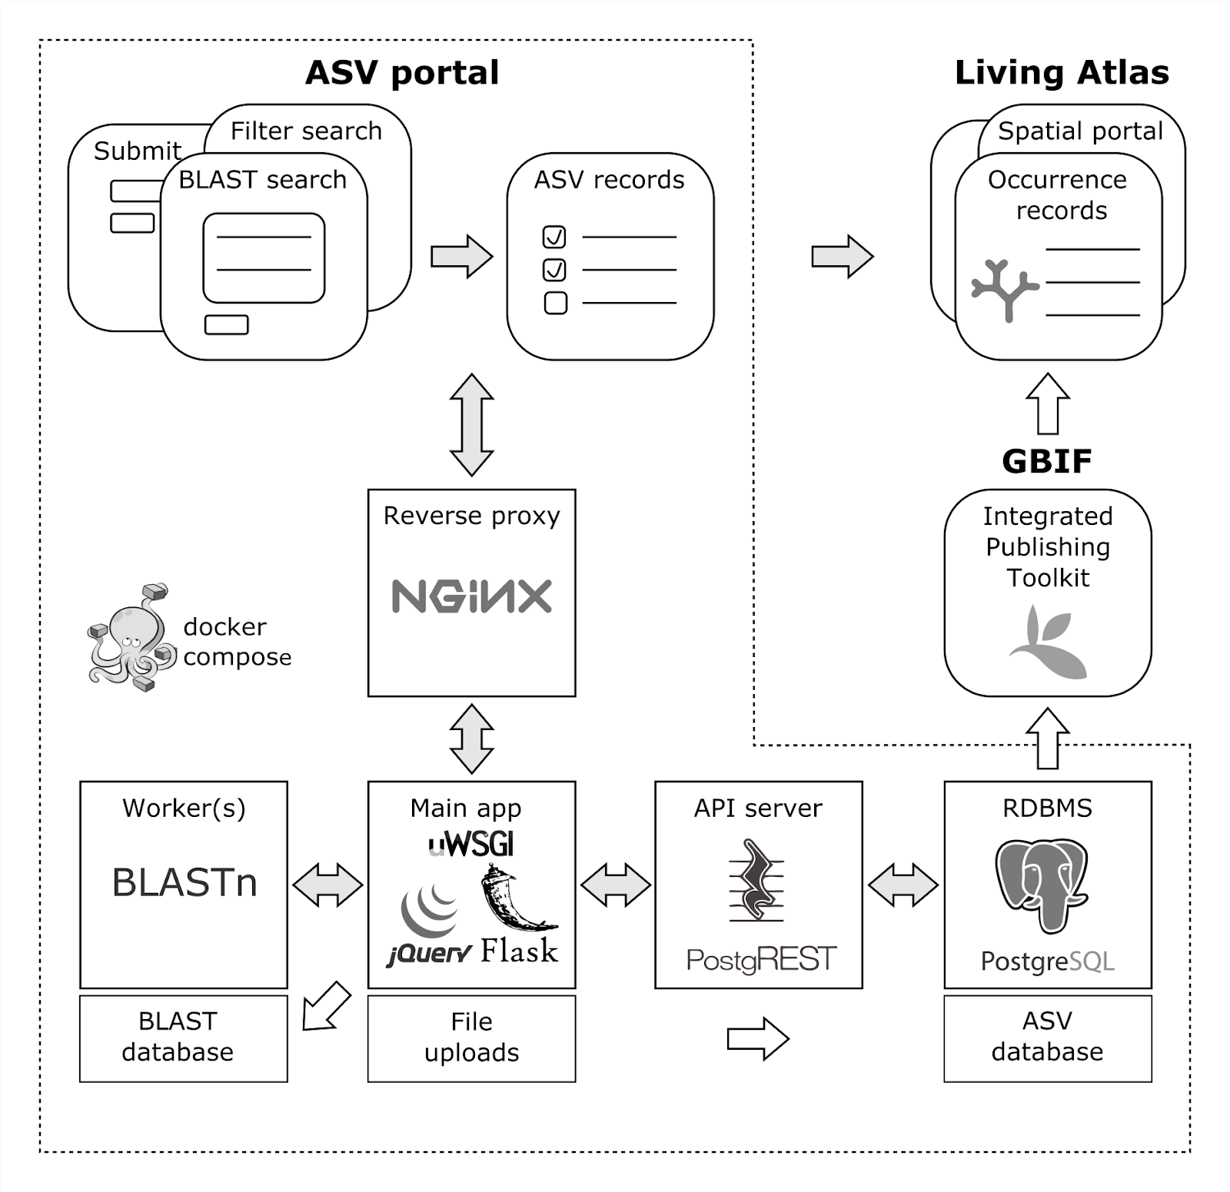
ASV portal: components
5 microservices orchestrated with Docker Compose

Slide 4
ASV portal: flow
7. taxonID:s are POST:ed to
Bioatlas occurrences search page
1. Web user submits ASV data
5. Bioatlas manager imports DwCA from IPT
6. Web user searches for ASVs & occurrence records
4. Imported data are accessible as DwC views in our IPT
3. Imported sequences are used for (re-)building custom BLAST DB
2. Submitted data are re-annotated and imported into ASV db

Slide 5
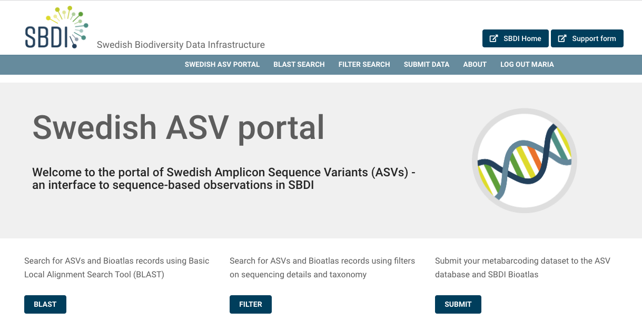
ASV portal: Index page (asv-portal.biodiversitydata.se)

Slide 6
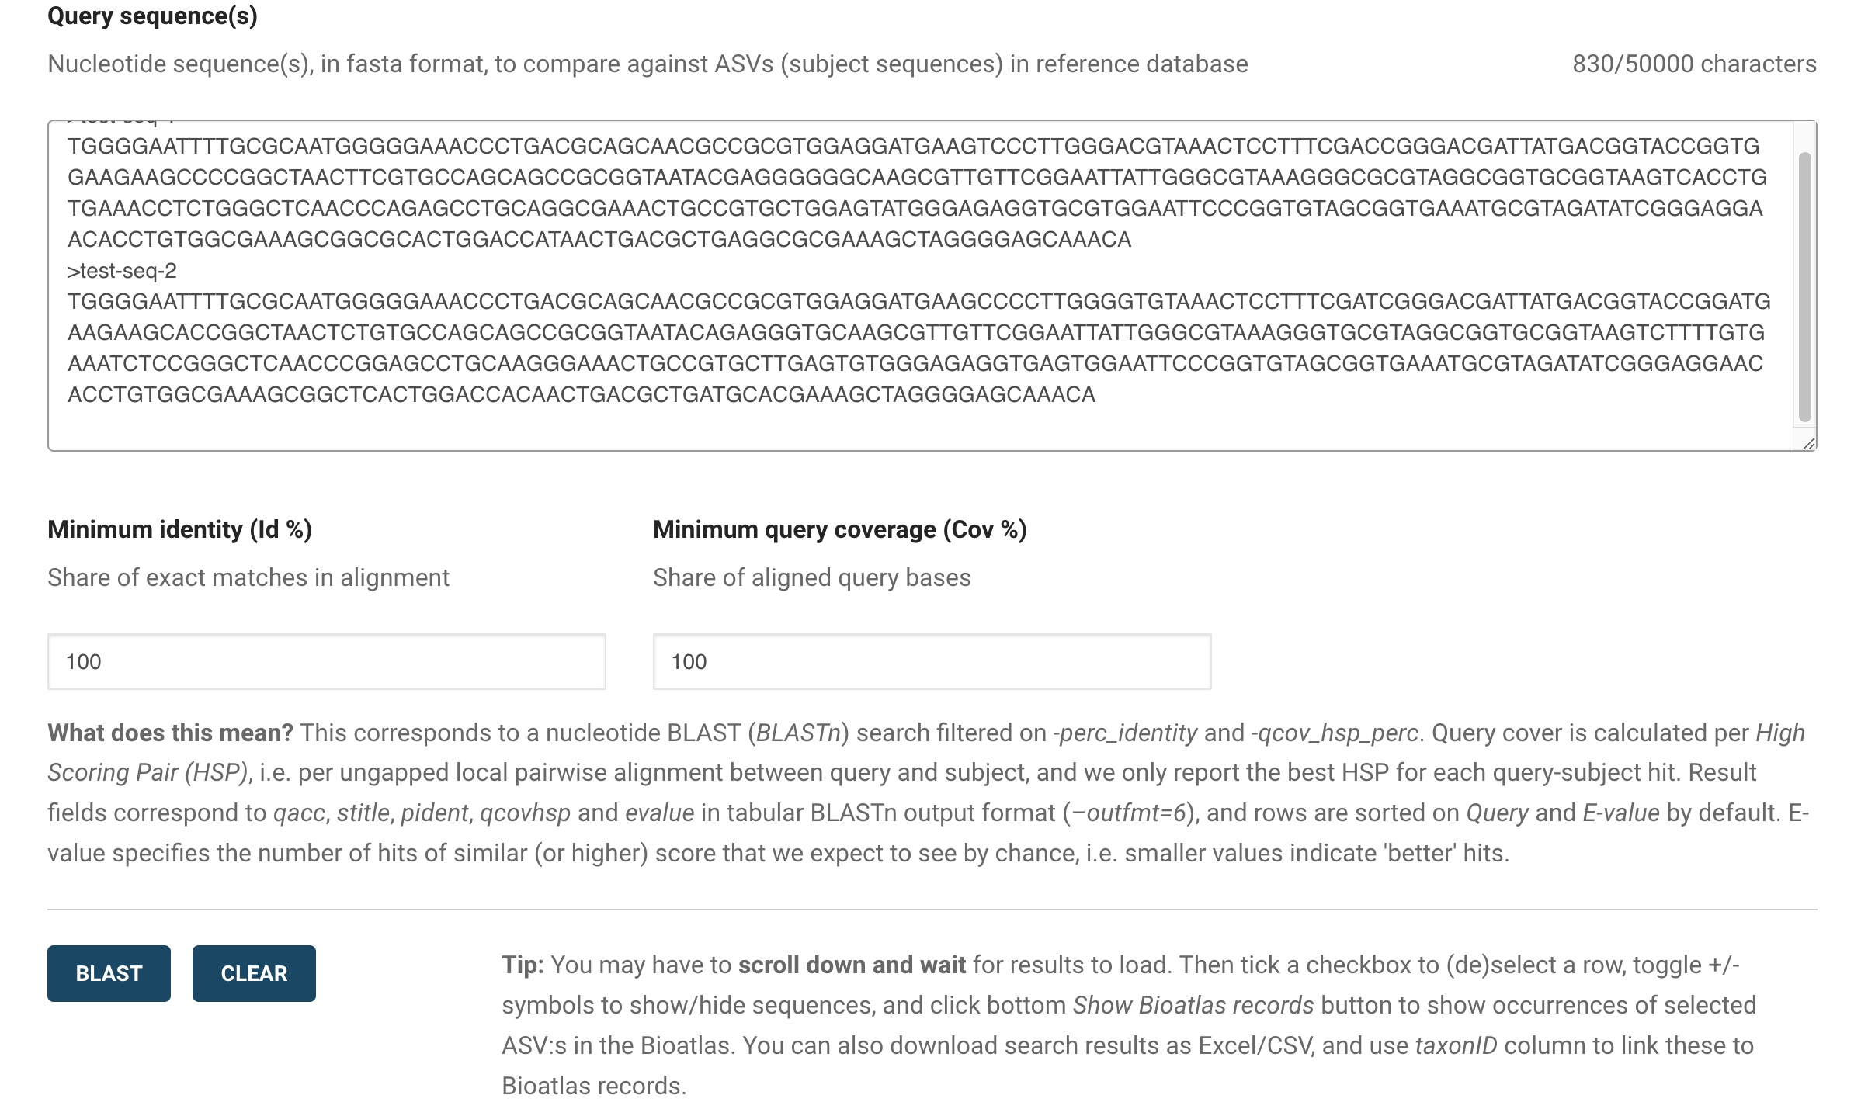
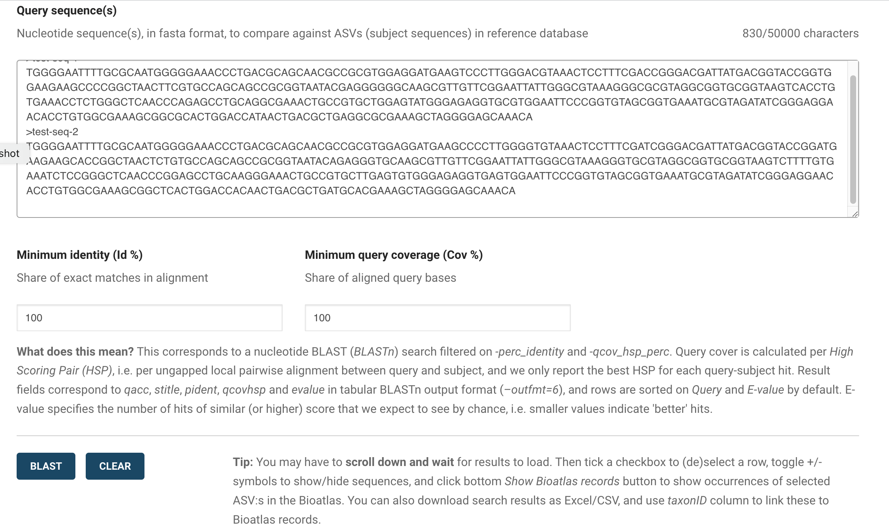
ASV portal: BLAST search

Slide 7
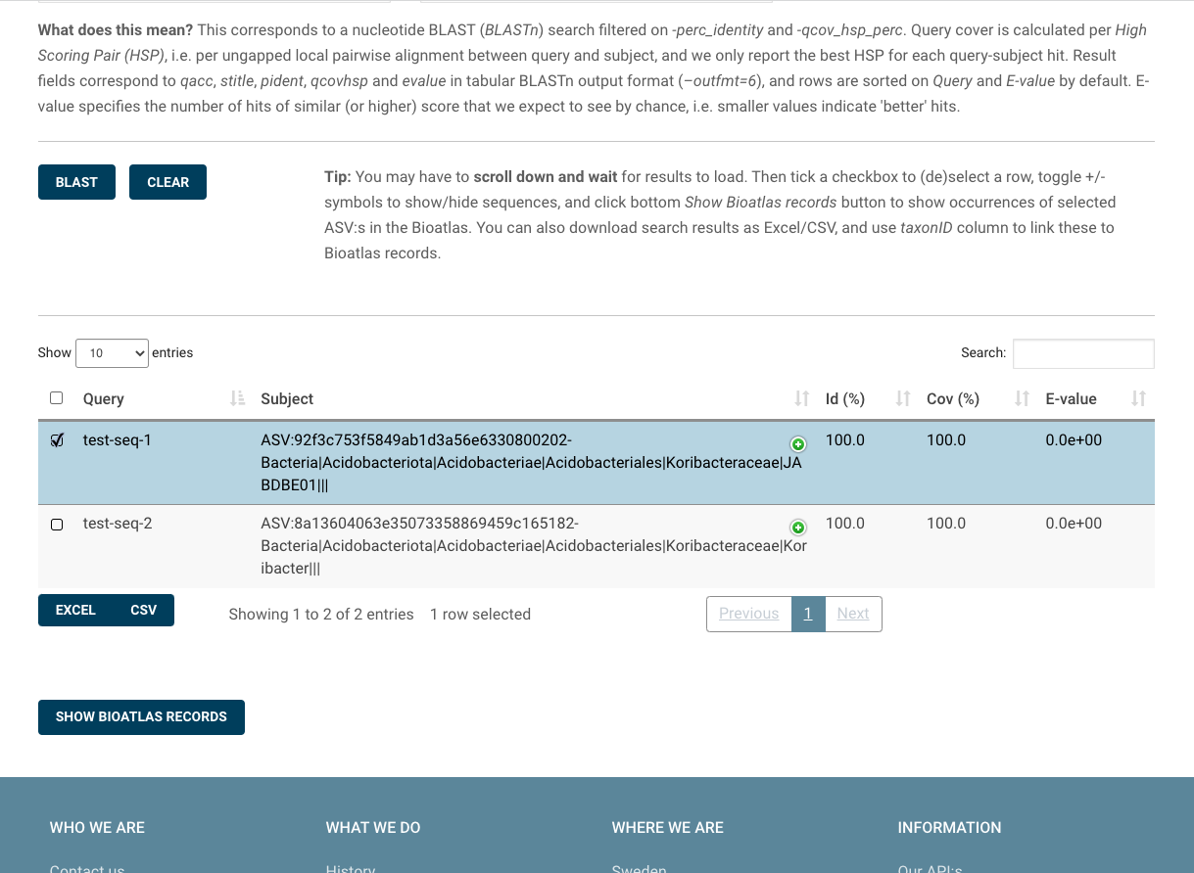
ASV portal: BLAST results

Slide 8
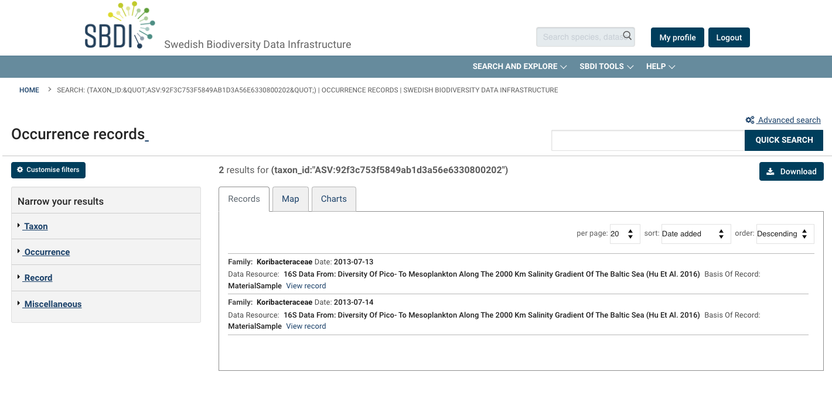
Bioatlas: ASV occurrence records

Slide 9
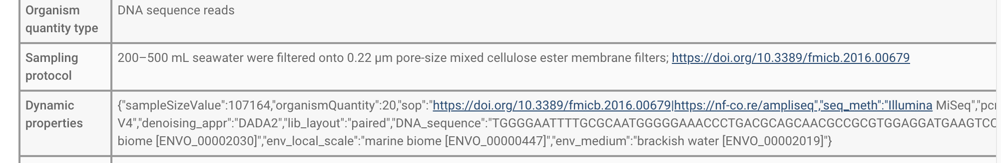
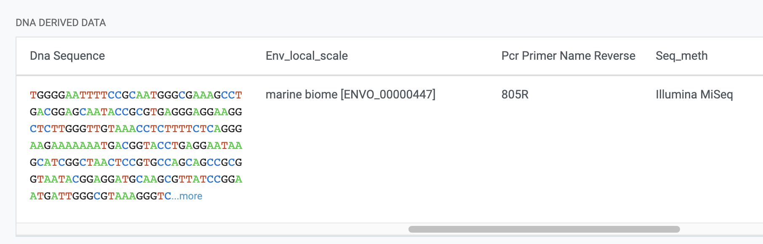
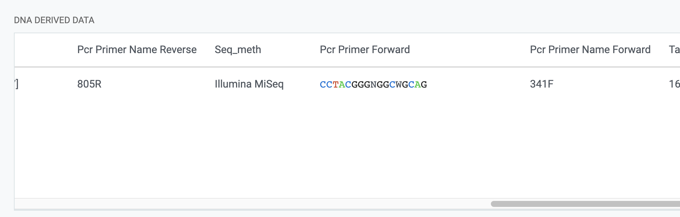
Possible collaboration: Handling of ‘DNA derived data’ extension fields
Bioatlas
Extension fields not ingested / indexed / accessible for web display or via R
vs. GBIF

Slide 10
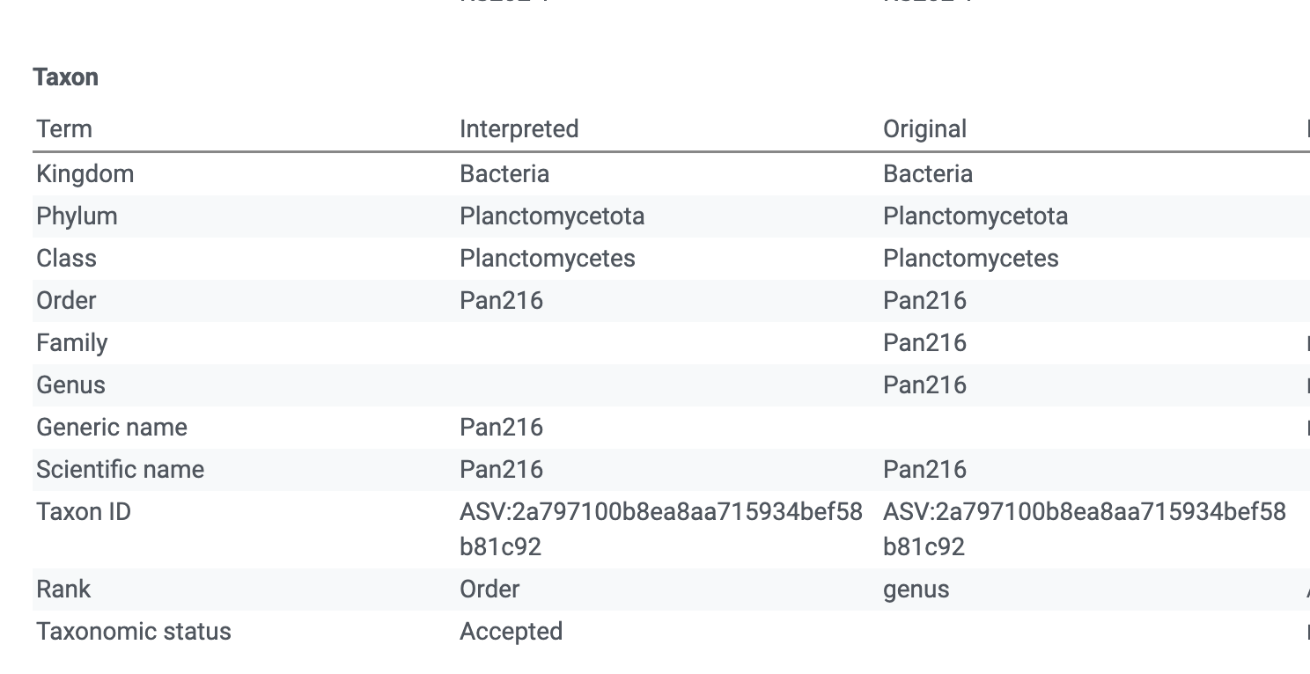
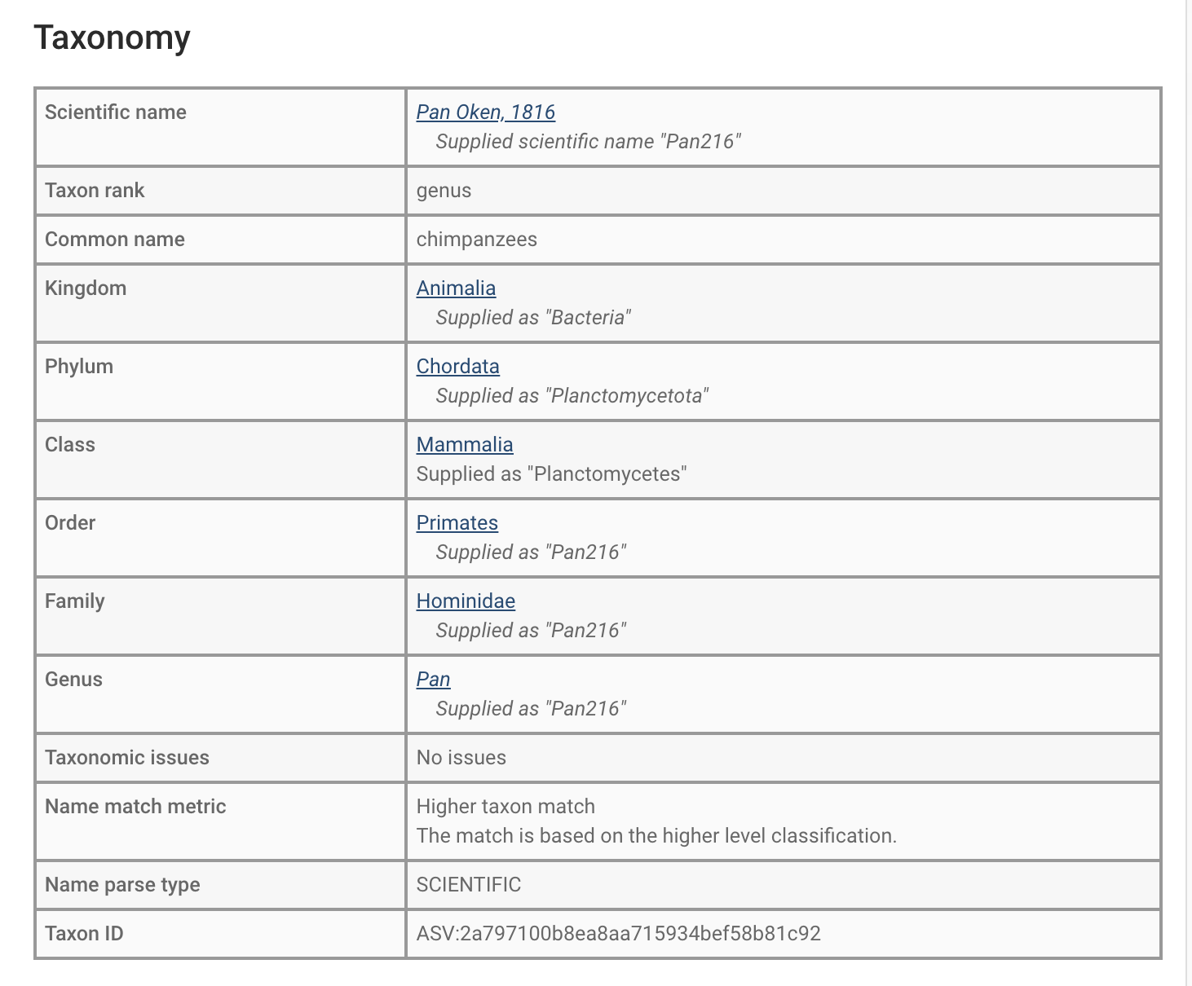
Possible collaboration: Improved name-matching
GBIF
ASV portal
Bioatlas
Taxonomy improved with addition of GTDB to GBIF backbone, but some issues remain.
Non-Linnean placeholder names misinterpreted, and higher taxonomy is ignored.

Slide 11
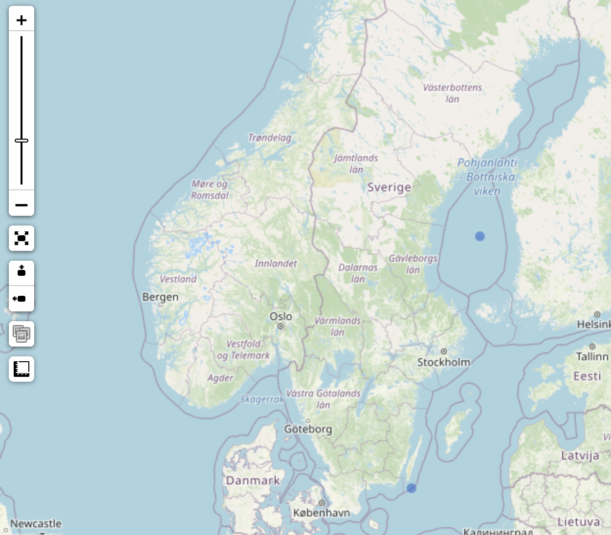
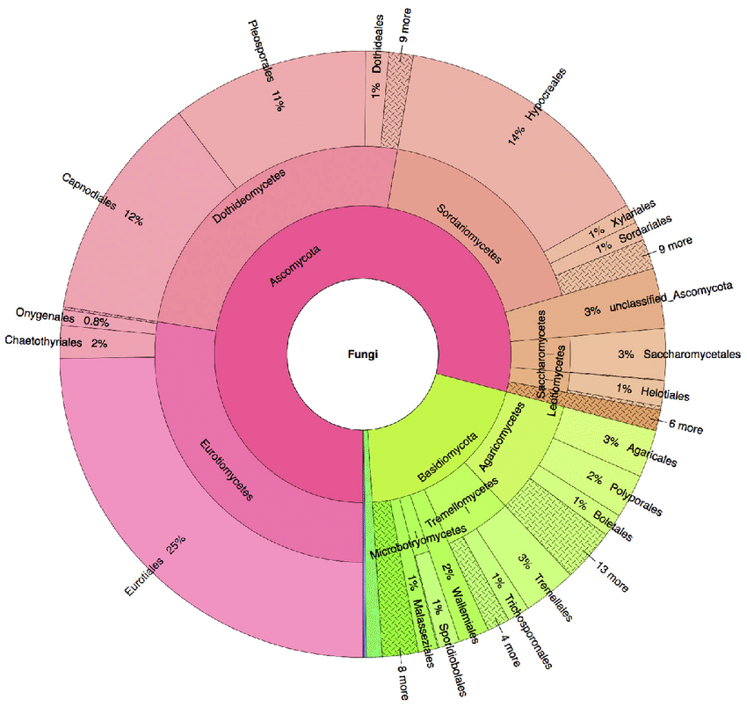
Possible collaboration: Visualisation of metabarcoding/eDNA
Map display of relative abundance
= [Organism quantity] / [Sample size value]
(i.e. ratio of DNA sequence read counts)
Marker size (log scale), pie charts at some rank, or full taxonomic Krona charts...?

Slide 12
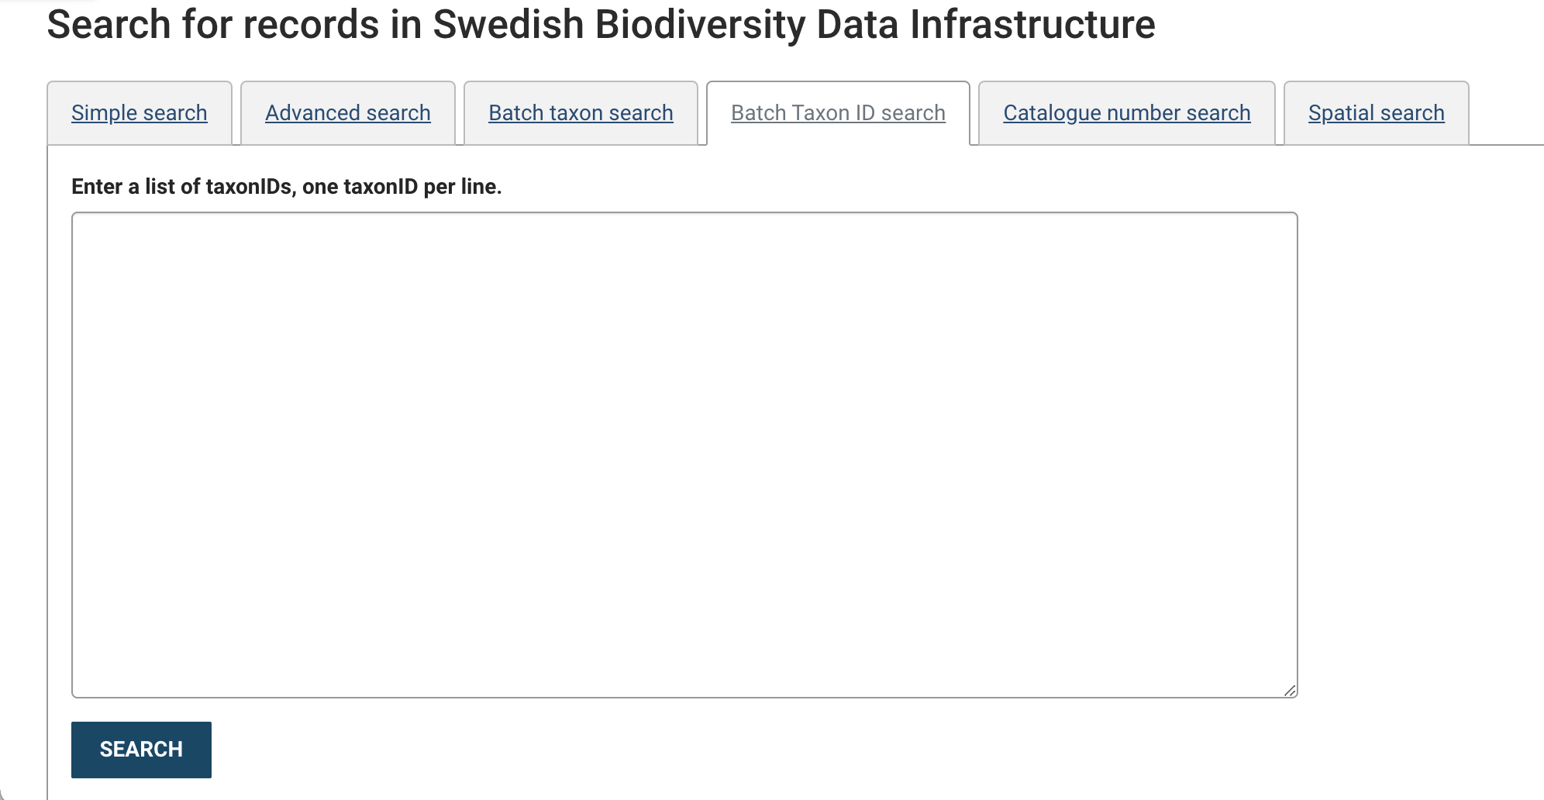
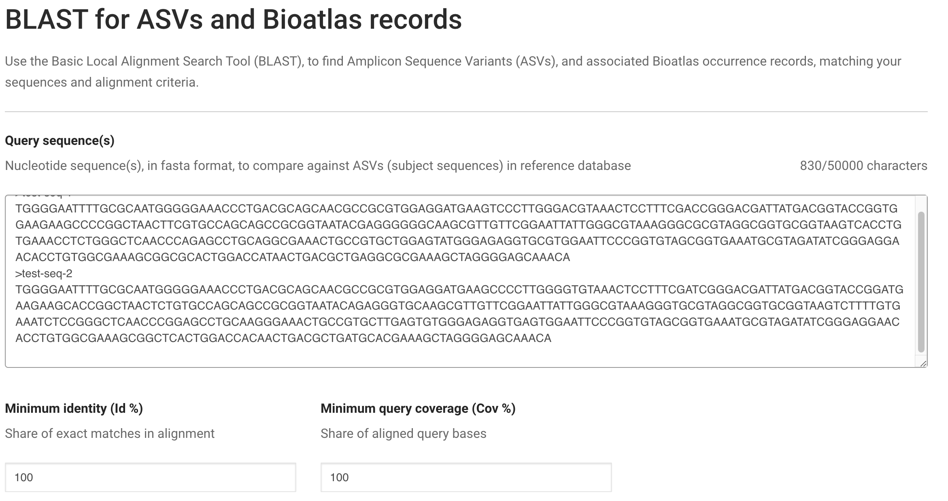
Possible collaboration: Full integration of ASV portal into Living Atlas
Sequence search

Slide 13

Funding for collaboration?
Inter‐governmental research infrastructure that aims to unify bioinformatics resources and life science data across Europe, thereby facilitating their mining and (re‐)use.

